Slide 1
Polk County - Ocoee Corridor K
US-64/SR-40
September 10, 2024

Slide 2
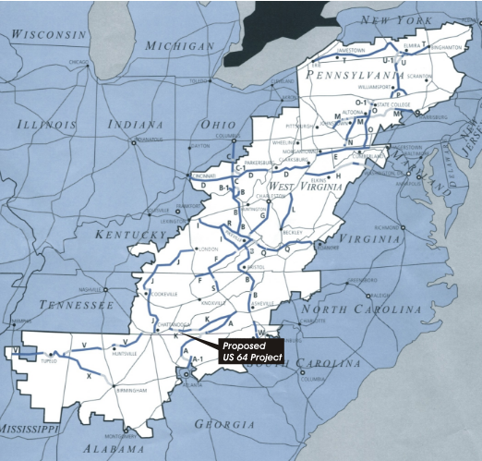
Background
Part of the Appalachian Development Highway System (1965)
Safe and reliable east-west route
Improve mobility and connectivity in the area
Multiple previous attempts to develop projects in the corridor
Notes:
Corridor K originally proposed in Appalachian Regional Development Act in 1965 as part of the Appalachian Development Highway System (ADHS)
From I-75 near Cleveland, TN to Dillsboro, NC.
Goal of the ADHS is to generate economic development across Appalachia by providing access to regional and national markets and provide growth opportunities.
This section of Corridor K is one of the last incomplete sections.
Originally proposed as a 4-lane divided, 50 mph facility.
Numerous efforts to develop project hindered by cost and other constraints.

Slide 3
US-64/SR-40 “Corridor K” - TDOT History
1965
Corridor K is one of 31 projects originally listed in ARDA
2008
Cost and issues raised by public, interest groups, resource agencies lead to rescission of DEIS
TDOT begins planning work
(including NEPA)
Project does not advance due to lack of funding
1970s
2009
Major Rockslide
2009/10
Current EIS planning & NEPA begins
1980s
TDOT/FHWA develop EA, approved-1990.
FONSI never approved. 1993 project placed on indefinite hold
2014 –17
Adding long tunnel option developed & distributed.
2018
Targeted Approach Developed & Pauses current EIS
TDOT/USFS prepare EA/FONSI.
Due to Financial/Environmental Cost to Benefit Ratio, FHWA does not adopt EA/FONSI
1990s
2020
ARC gives TDOT approval to move forward with Public Outreach Targeted Approach
1999
TDOT/FHWA initiate EIS
2022
ARC approved change from new alignment to targeted approach
Notes:
Started and stopped several Environmental Documents.
Most recent effort initiated in 2009 included 7 proposed options, including a 6-mile tunnel (likely favored option) which had an estimated cost of over $2 billion.
Rockslide – Route was detoured for over a year - 70 mile / 1.5 hour long detour.
While road was closed down, TDOT maintenance forces improved the radius of one of the curves.
In 2018, TDOT started pursuing a Targeted Approach for the Corridor. The ARC approved the Targeted Approach earlier this year.

Slide 4
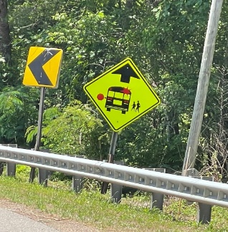
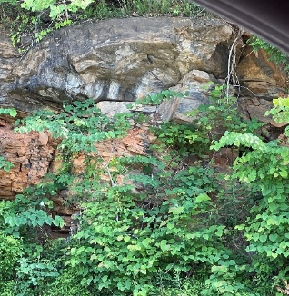
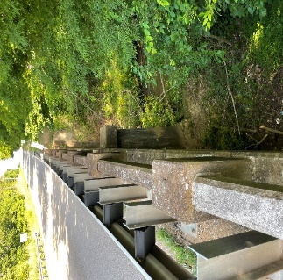
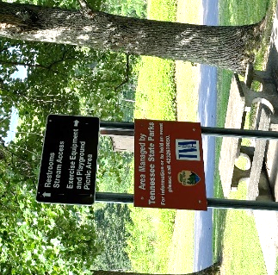
US-64/SR-40 “Corridor K”
CHALLENGES
TARGETED APPROACH
Located in Cherokee National Forest
Environmental Constraints
Topography
Cost
Multiple projects to address needs of corridor
35 Road Safety Audit Projects
14 Rockfall Mitigation Sites
Notes:
Numerous issues affected environmental review of project:
Cherokee National Forest – unique requirements, such as aesthetics, for projects within the forest and their own environmental processes
Alphabet soup of other agencies – ARC, FHWA,
Three dams along the river, so have to work with the TVA
Endangered species, pyritic material, TWRA, USFWS, TDEC, etc.
River on one side, mountains on the other
Recreation, including whitewater rafting, is a major economic driver for the area
Challenges in maintaining access for all the recreational traffic
In 2018, TDOT decided to take a fresh look at the Corridor to determine if something could be done to the existing facility to improve the safety and reliability and meet the intent of the ADHS.
We found that transportation deficiencies were more localized than system-wide.
Developed the Targeted Approach which included 35 projects to address specific needs of the corridor, such as improving some horizontal curves, mitigating potential rockfall hazards, and adding shoulders and turn lanes.

Slide 5
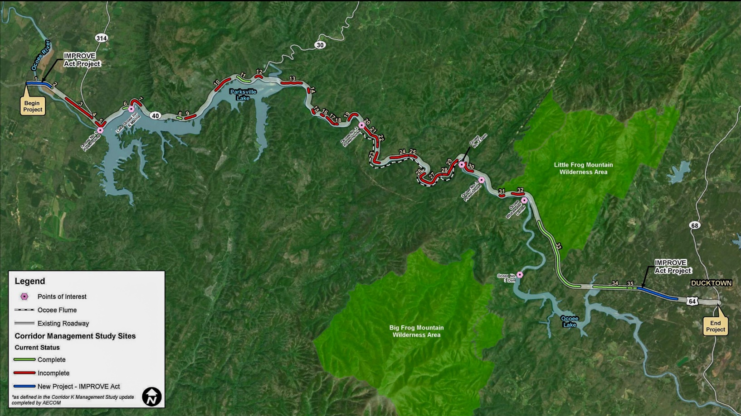
US-64/SR-40 “Corridor K” Overview
Targeted
Approach
CORRIDOR K
SR-40 (US-64) From West of the Ocoee River to SR-68 Near Ducktown
Polk County, TN,
PIN 102420.08

Slide 6
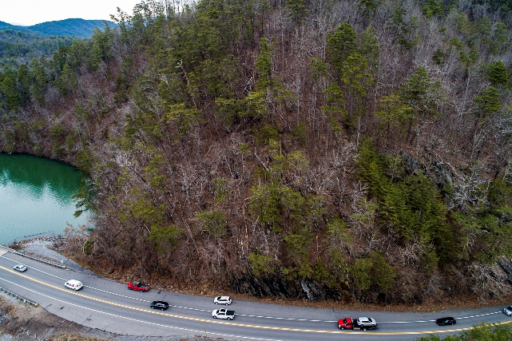
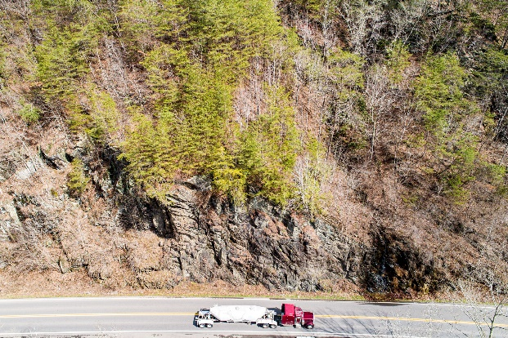
Traffic/Safety
Safety First
Drives many of the improvements
Geometric deficiencies
Parking/Pedestrians
Traffic Characteristics
Regional Corridor
5,000 – 6,000 ADT
9-10% Trucks

Slide 7
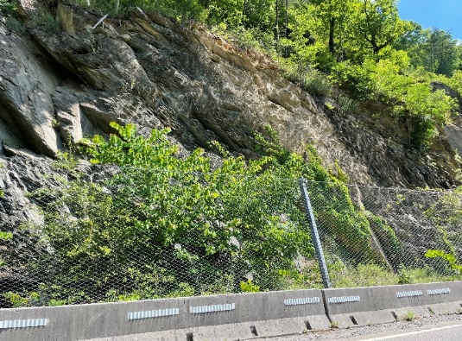
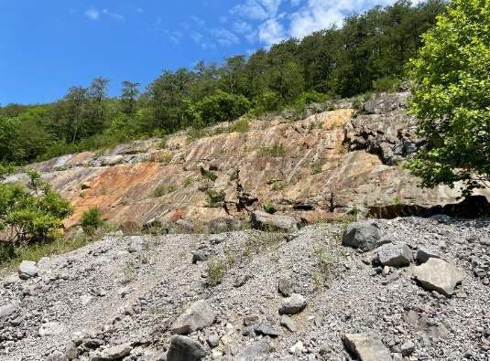
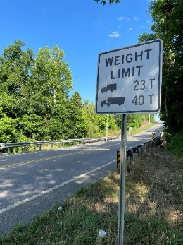
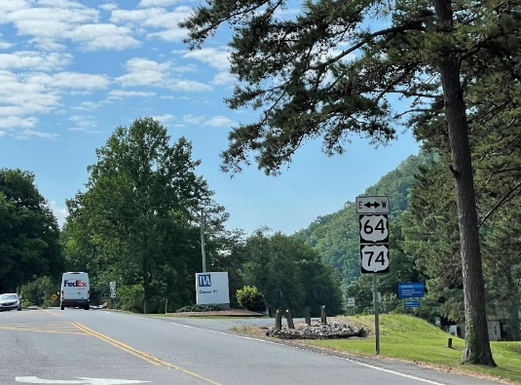
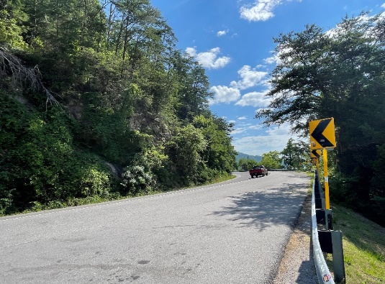
Targeted Approach
Geometric improvements
Signage/pavement markings
Guardrail
Rockfall/geotechnical improvements
Intersection improvements

Slide 8
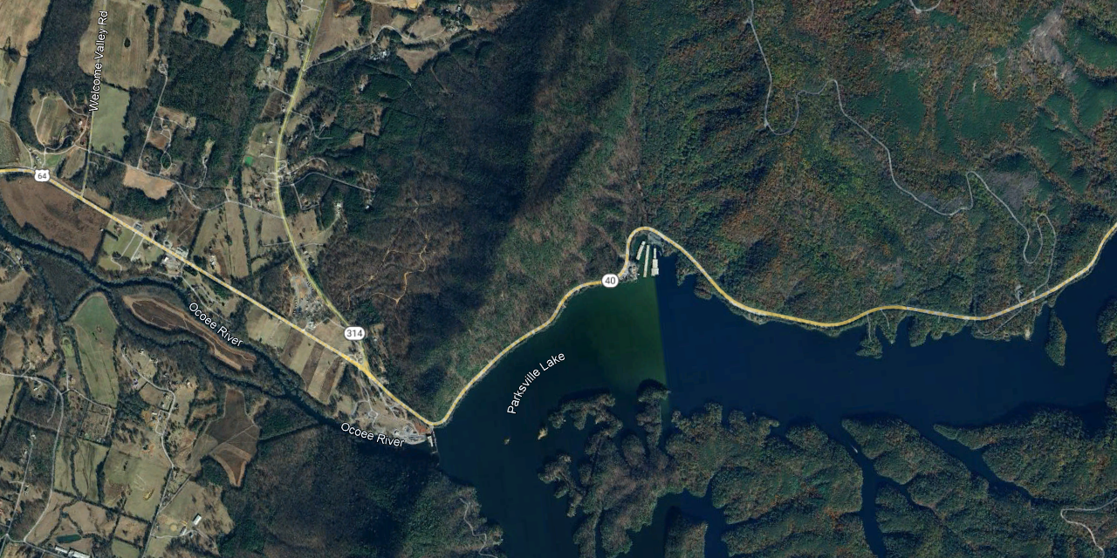
Programmed Projects
In 2023 and 2024 four projects were chosen to progress toward implementation
All four currently in the environmental studies and engineering phases
Location 7
Location 3
Location 9
Location 4

Slide 9
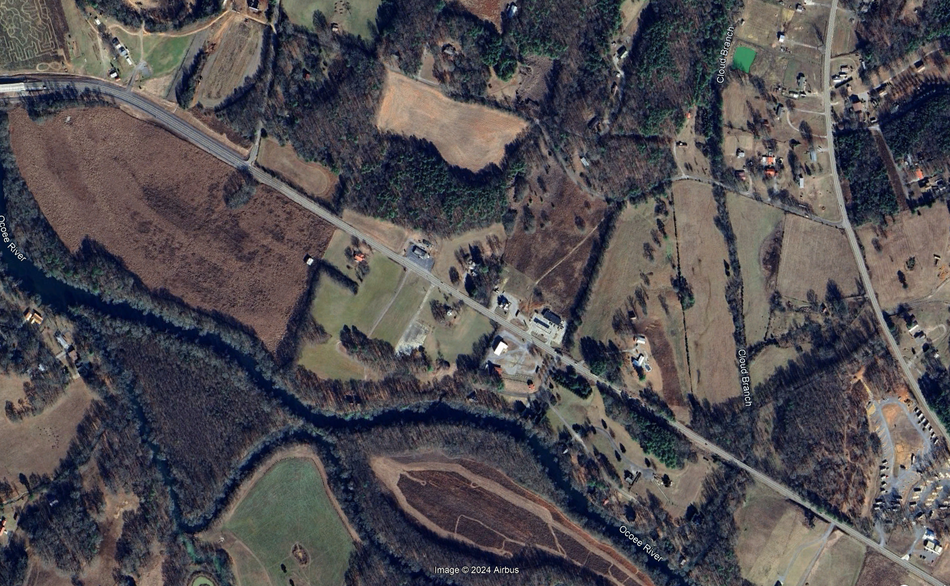
Location 3
Approx. 1.1 mile widening to 3 lanes with paved shoulders
10’ shared use path on south side to connect existing maintenance road west of Welcome Valley Road that connects to Ocoee River
200’ Cloud Branch Bridge Replacement
Geometric Improvements
45 mph design speed
ROW – FY 2025
Construction – FY 2026

Slide 10
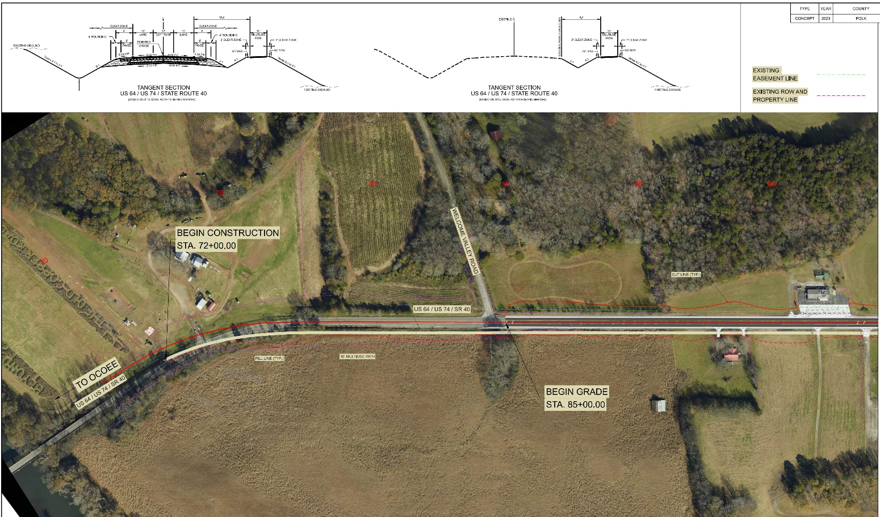
Location 3

Slide 11
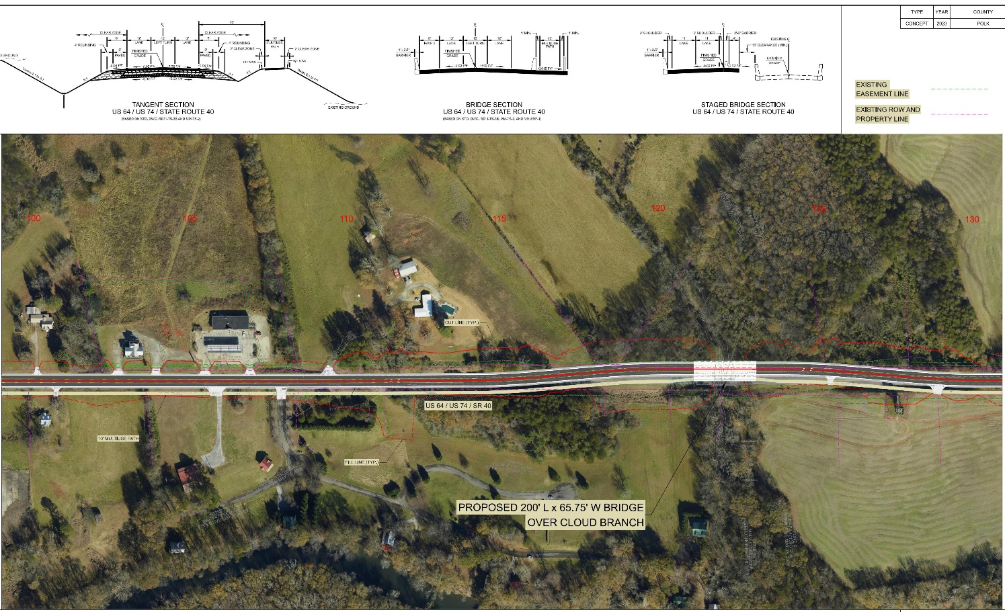
Location 3

Slide 12
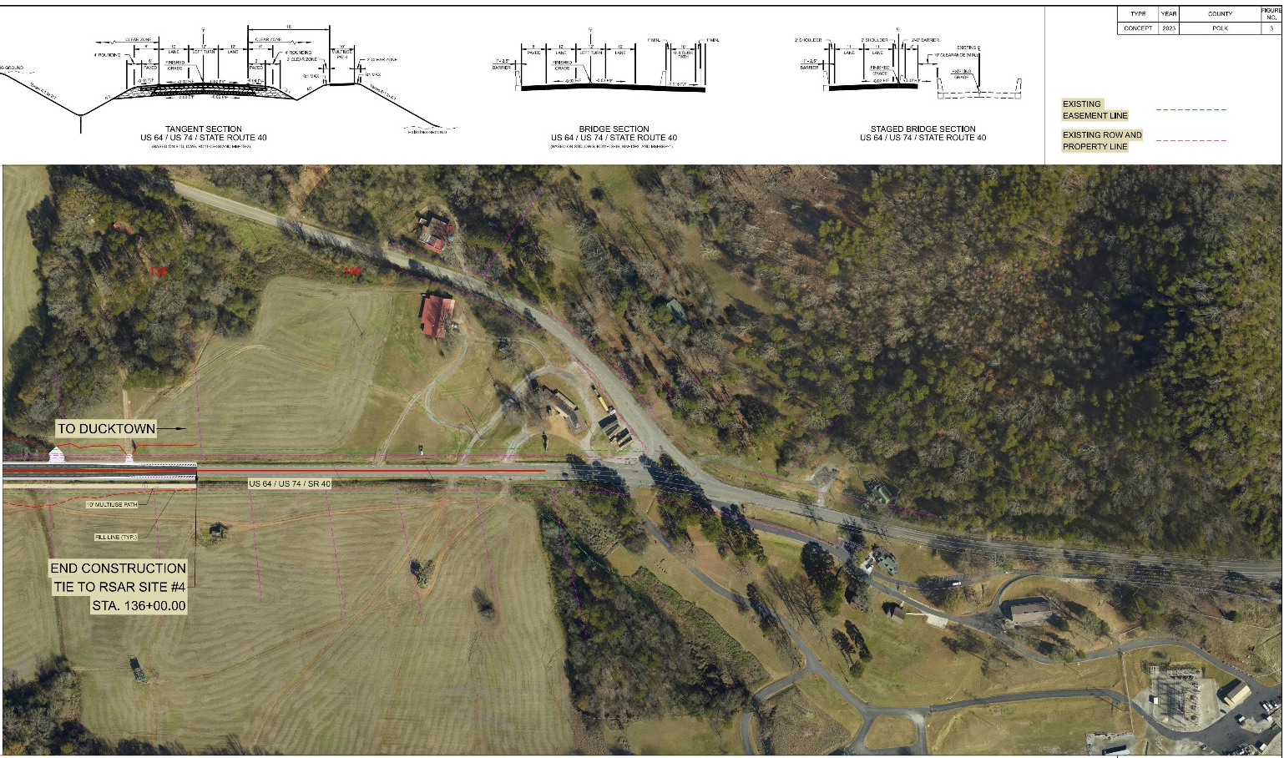
Location 3

Slide 13
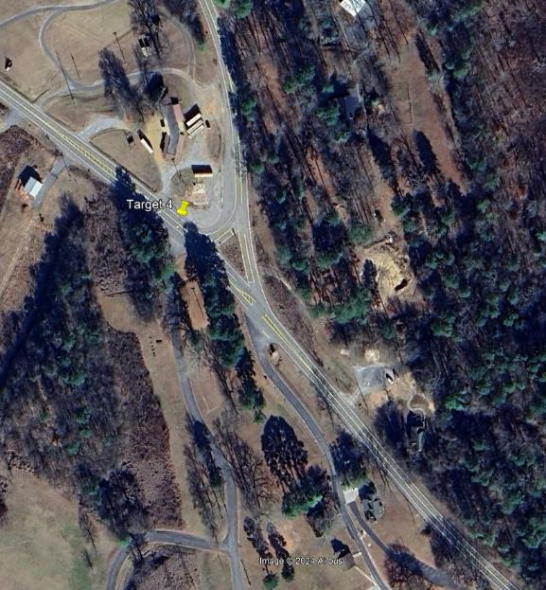
Location 4
Intersection Improvements
Realigning SR-314 (Parksville Road) to provide safer turning movements
Widening SR 40 to 3 lanes and 6’ shoulders
Adds 10’ shared use path to provide access between Ocoee River and Sugarloaf Mountain Park
Consolidate access drives for TVA and Sugarloaf Mountain Park to simplify/improve ingress/egress
ROW – FY 2025
Construction – FY 2026

Slide 14
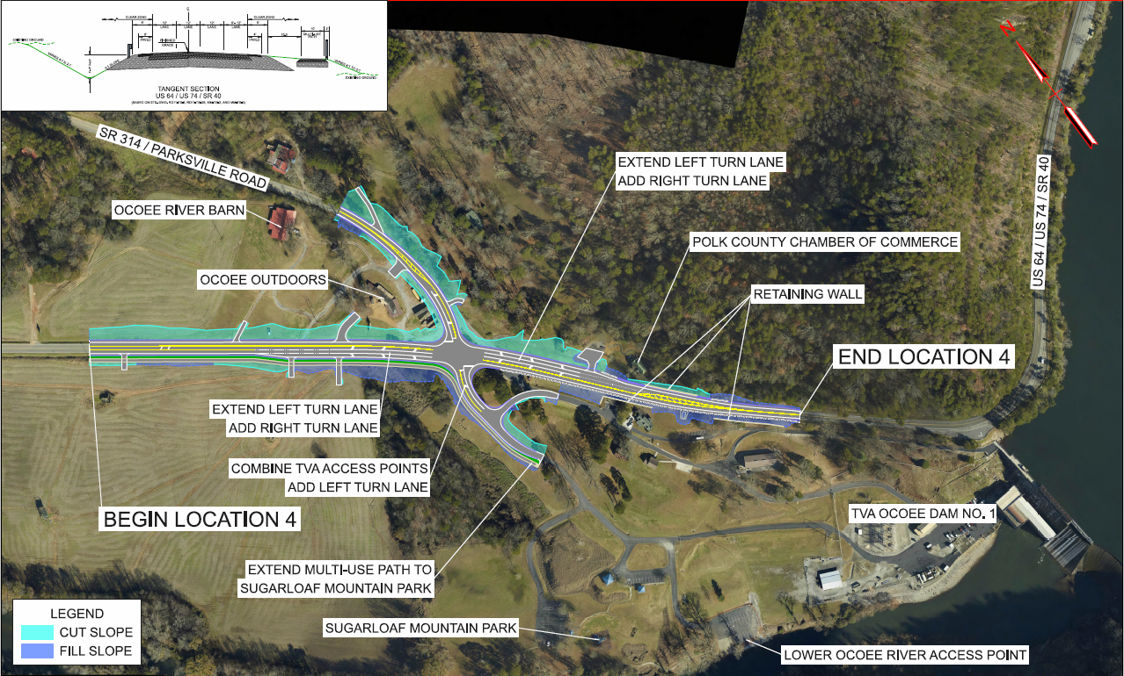
Location 4

Slide 15
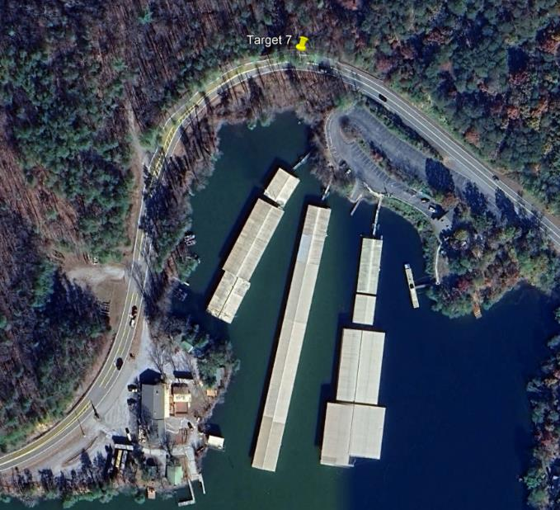
Location 7
Improve traffic flow/circulation around high activity center
Improve horizontal curve to 35mph
Add new entrance to marina with dedicated eastbound right turn and westbound left turn
Convert existing driveway that is both entry and exit to marina to exit only
ROW – FY 2026
Construction – FY 2027

Slide 16
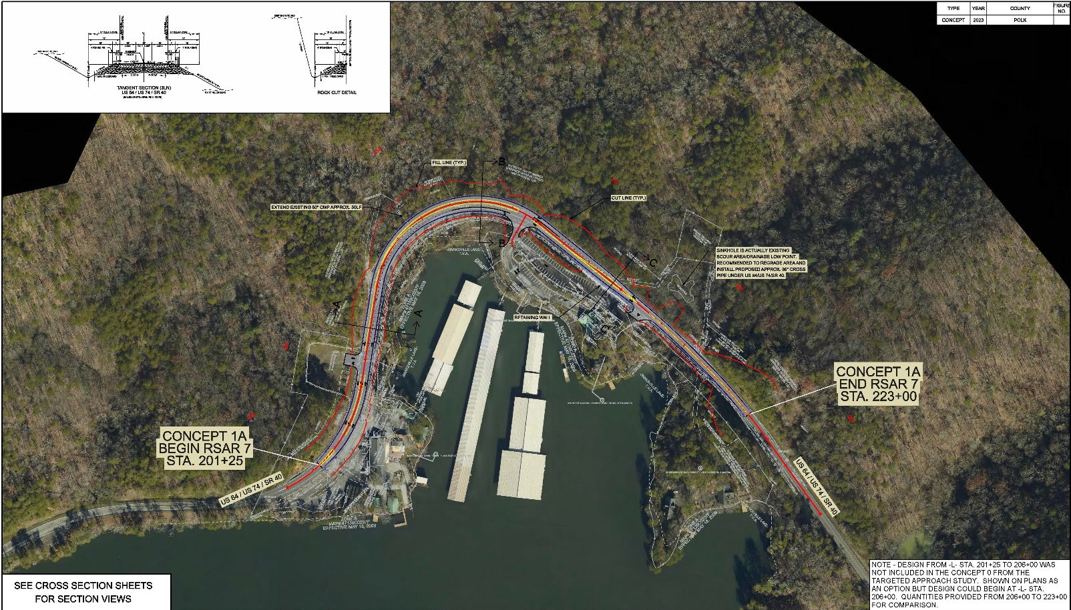
Location 7

Slide 17
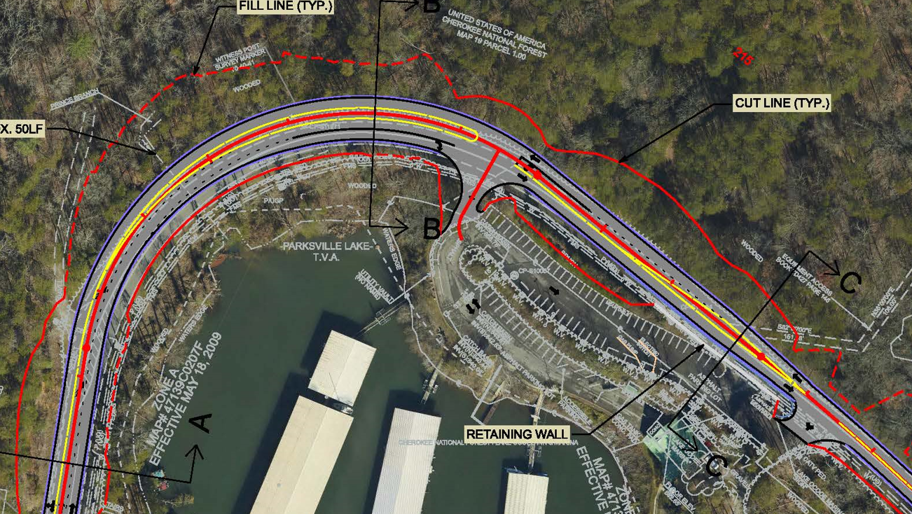
Location 7

Slide 18
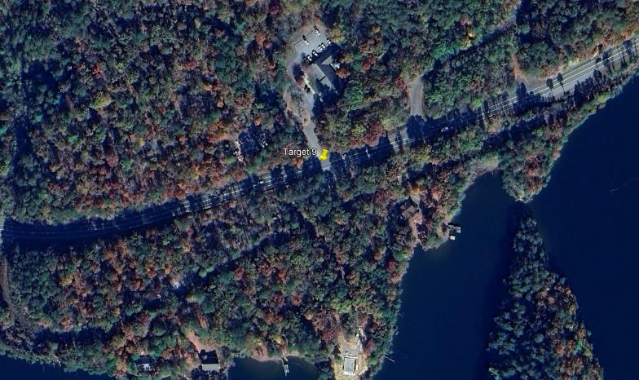
Location 9
Improve traffic flow/circulation around USFS Ranger Station and Oswald Road
Consolidating Ranger Station access to Oswald Road
Adding EB left turn lane onto Oswald
ROW – FY 2026
Construction – FY 2027

Slide 19
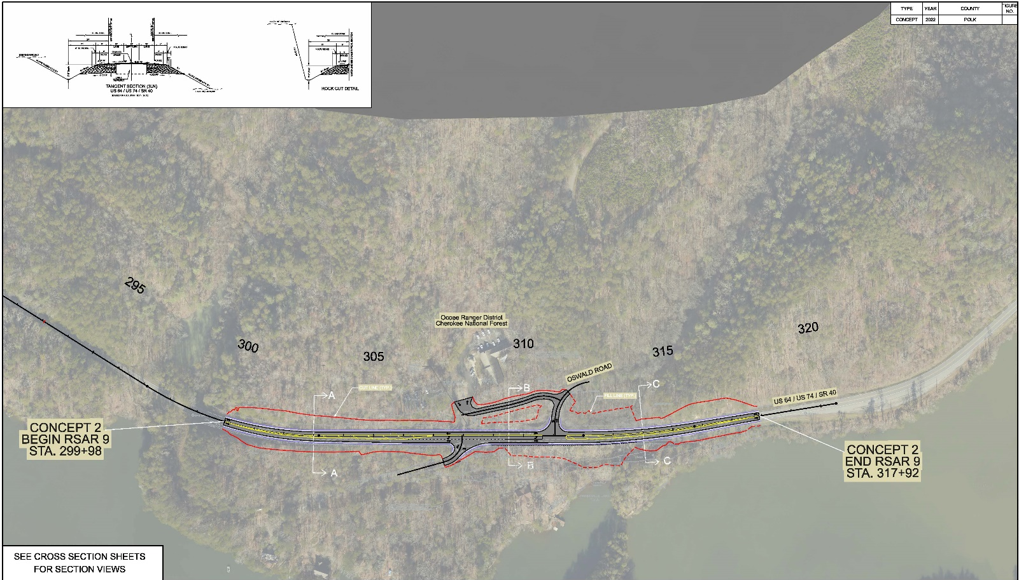
Location 9

Slide 20
Next Steps
Finalize preliminary engineering, incorporating environmental features for Locations 3 and 4
Complete environmental studies for Locations 3, 4, 7, and 9
Continue design process for Locations 3, 4, 7, and 9
Advance all 4 projects to construction
Begin Development of Design Plans and Environmental Studies for Additional Locations
What to expect next as property owners
Be on the lookout for survey crews, ecologists, archaeologists, etc.
If driving in the corridor, be on the lookout for workers

Slide 21
Future Projects
Targeted Approach Location | Project Type
Location 5 | Geometric Improvement
Locations 10 and 12 | Geometric Improvements
Locations 13 – 18 | Geometric and rockfall mitigation
Locations 19 – 22 | Geometric and rockfall mitigation
Locations 23 – 25 | Geometric and rockfall mitigation
Locations 26 – 30 | Geometric and rockfall mitigation
Locations 31 and 32 | Geometric and rockfall mitigation

Slide 22
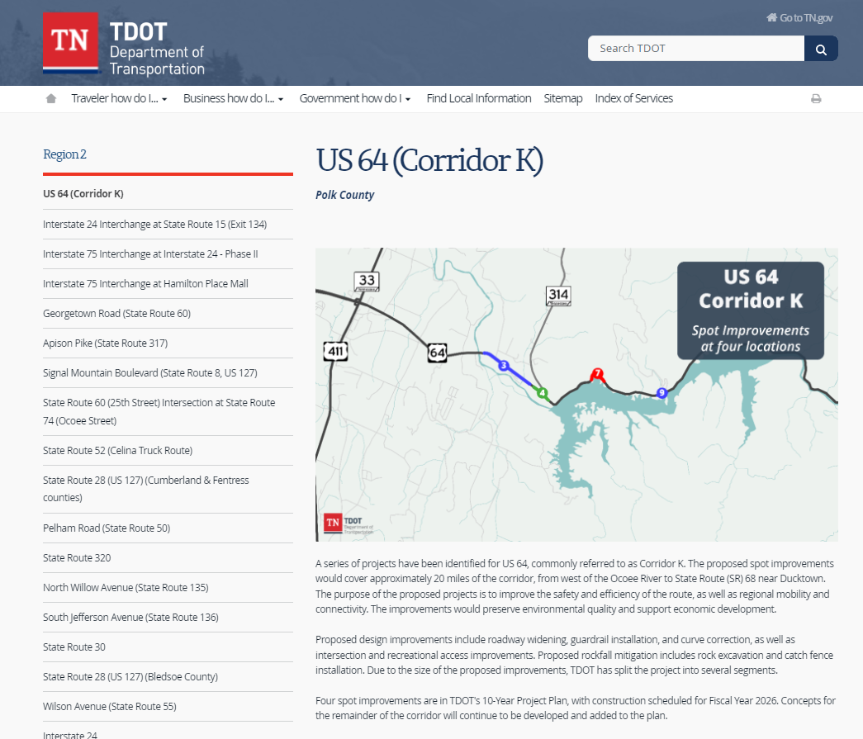
More Information

Slide 23
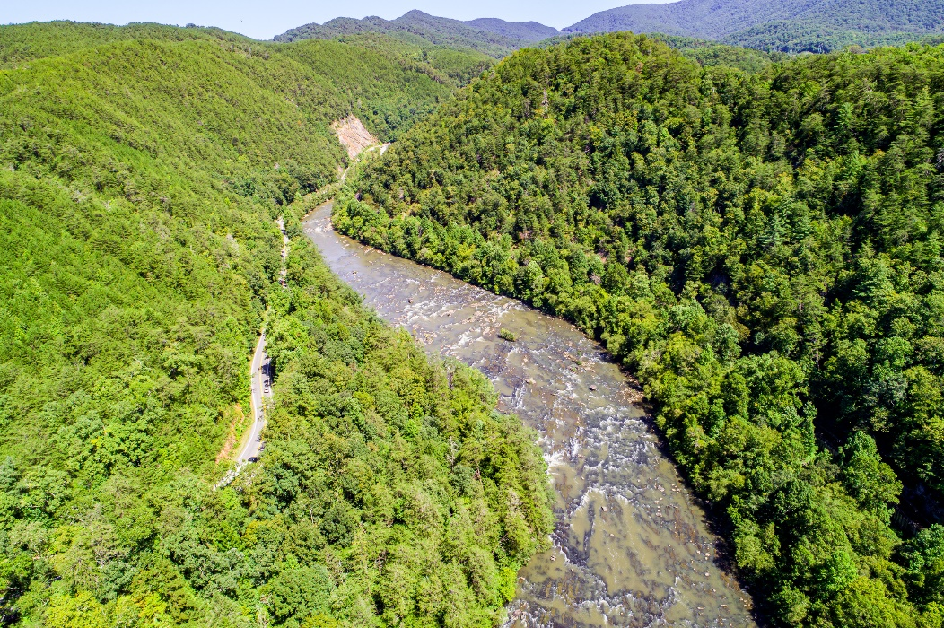
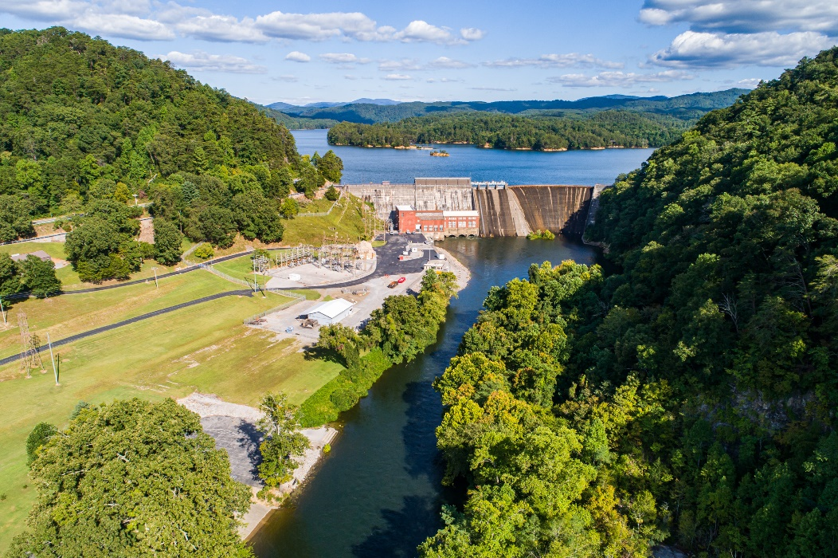
Thank You

